Slide 1
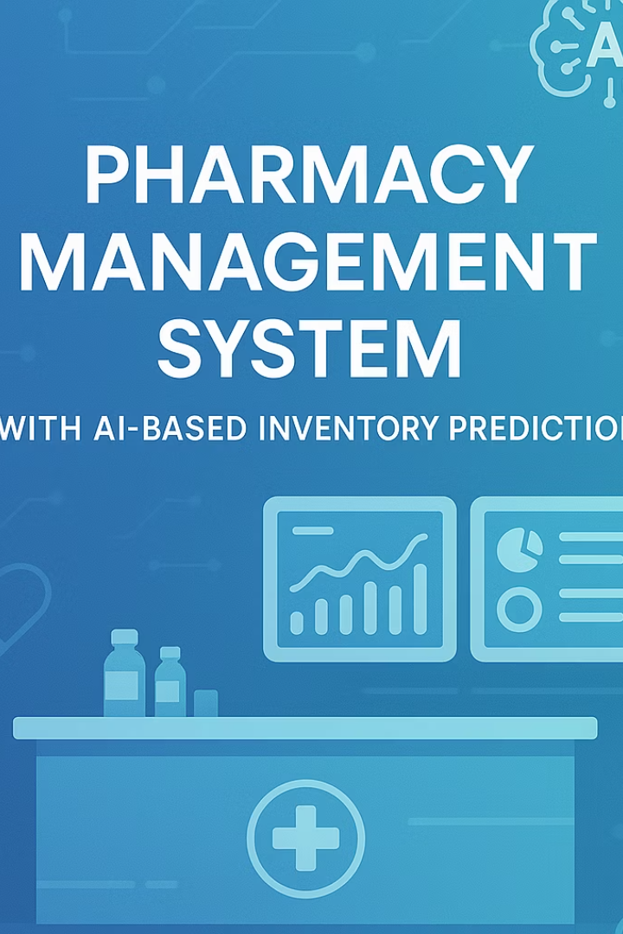
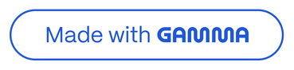
Pharmacy Management System with AI-Based Inventory Prediction
Mukthanand Reddy
22STUCHH010667
Section-D
Notes:
1

Slide 2












Contents
Introduction
Objectives
Features of the System
Tech Stack
System Architecture
Core Modules
Database Design
AI Model
Testing and Validation
Results and Output
Conclusion
Notes:
2

Slide 3
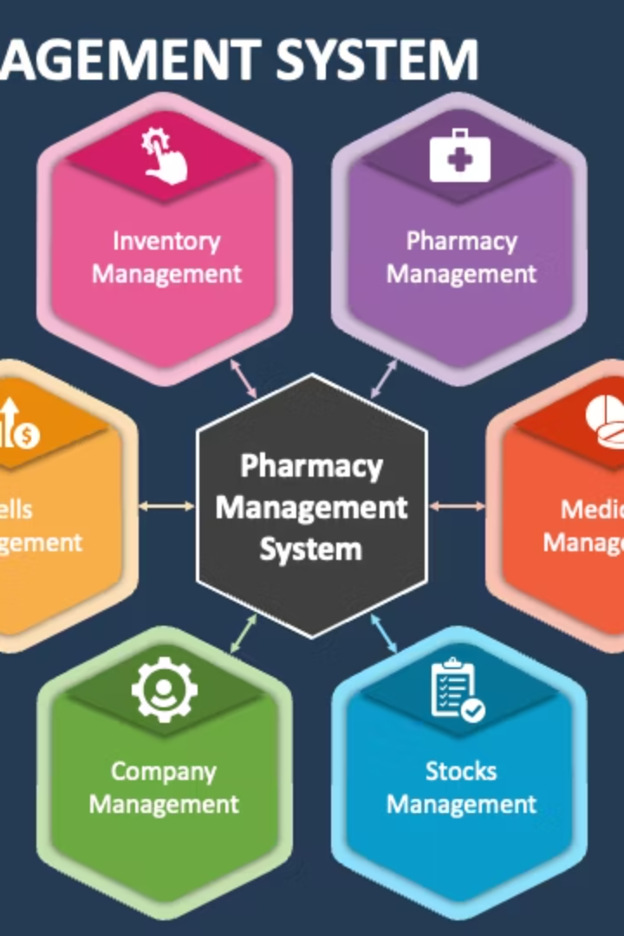



1.Introduction
Pharmacy Management Systems
Inventory Importance
Software designed to manage pharmacy operations and inventory efficiently.
Efficient stock control prevents shortages and reduces waste.
AI-Based Prediction
Uses data and machine learning to forecast medicine demand accurately.
Notes:
3

Slide 4
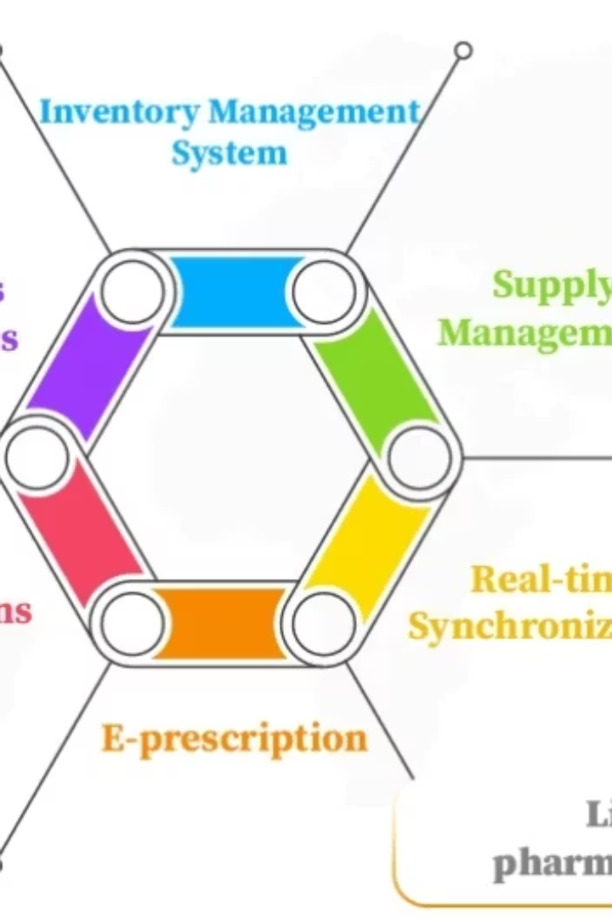

2.Problem Objectives
Automate inventory tracking in pharmacies
Use AI to forecast future stock demand
Prevent stockouts and overstocking
Enhance overall efficiency and decision-making
Notes:
4

Slide 5
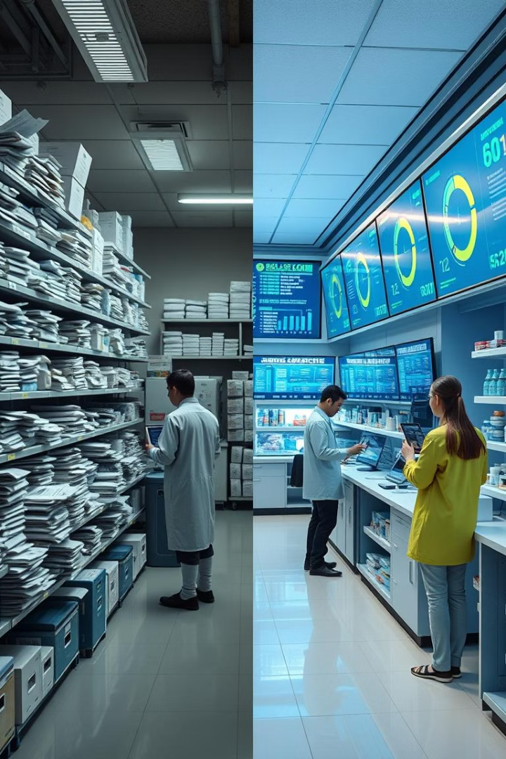
3.Existing vs. Proposed System
Existing System
Proposed AI-Based System
Manual tracking and spreadsheets
Automated, real-time AI-driven inventory
High chances of human error
Accurate demand forecasting
No real-time insights
Optimized stock levels with alerts
Inventory mismanagement
Reduced stockouts by up to 30%
Notes:
5

Slide 6





4. System Features
Real-Time Inventory Tracking
AI Demand Forecasting
Expiry Management & Alerts
Data-Driven Reporting
Monitor stocks continuously to avoid shortages.
Machine learning predicts future medicine needs.
Notifications help reduce wastage from expired medicines.
Provides actionable insights on sales and inventory trends.
User-Friendly Dashboard
Simple interface designed for pharmacy staff efficiency.
Notes:
6

Slide 7




5.Technologies Used
Programming Languages
Frameworks & Libraries
Database & Cloud
Python for AI and backend logic
Scikit-learn for Machine Learning
PostgreSQL for data storage
JavaScript for frontend interactivity
React for UI design
AWS, Azure, or Google Cloud for deployment
Flask for backend framework
Notes:
7

Slide 8
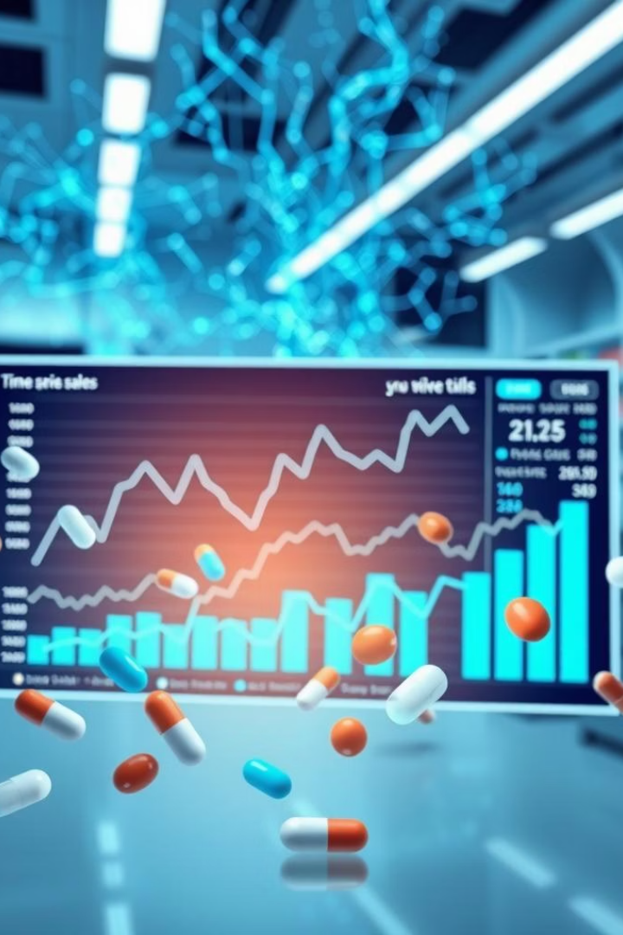
6.AI-Based Inventory Prediction
Data Collection
Model Training
Historical sales, seasonal trends, and external factors.
Algorithms like Linear Regression is used
Trained using extensive pharmacy data
Evaluation & Deployment
Model tested with real-world validation
Seamlessly integrated into PMS for realtime use
Notes:
8

Slide 9

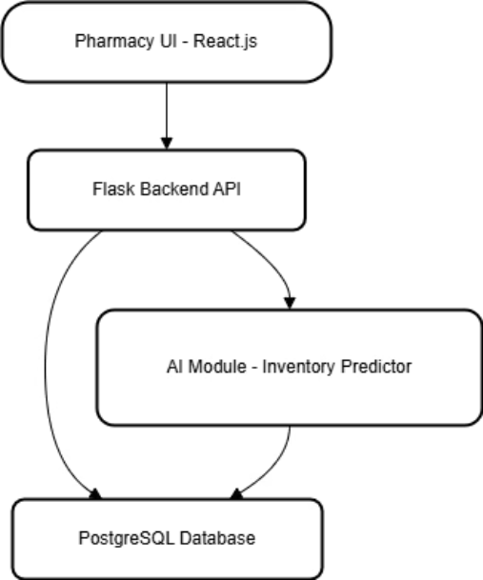
7. System Architecture
Modular architecture with clear separation of concerns
Frontend communicates via REST API
Backend handles logic and connects to database & AI model
Notes:
9

Slide 10
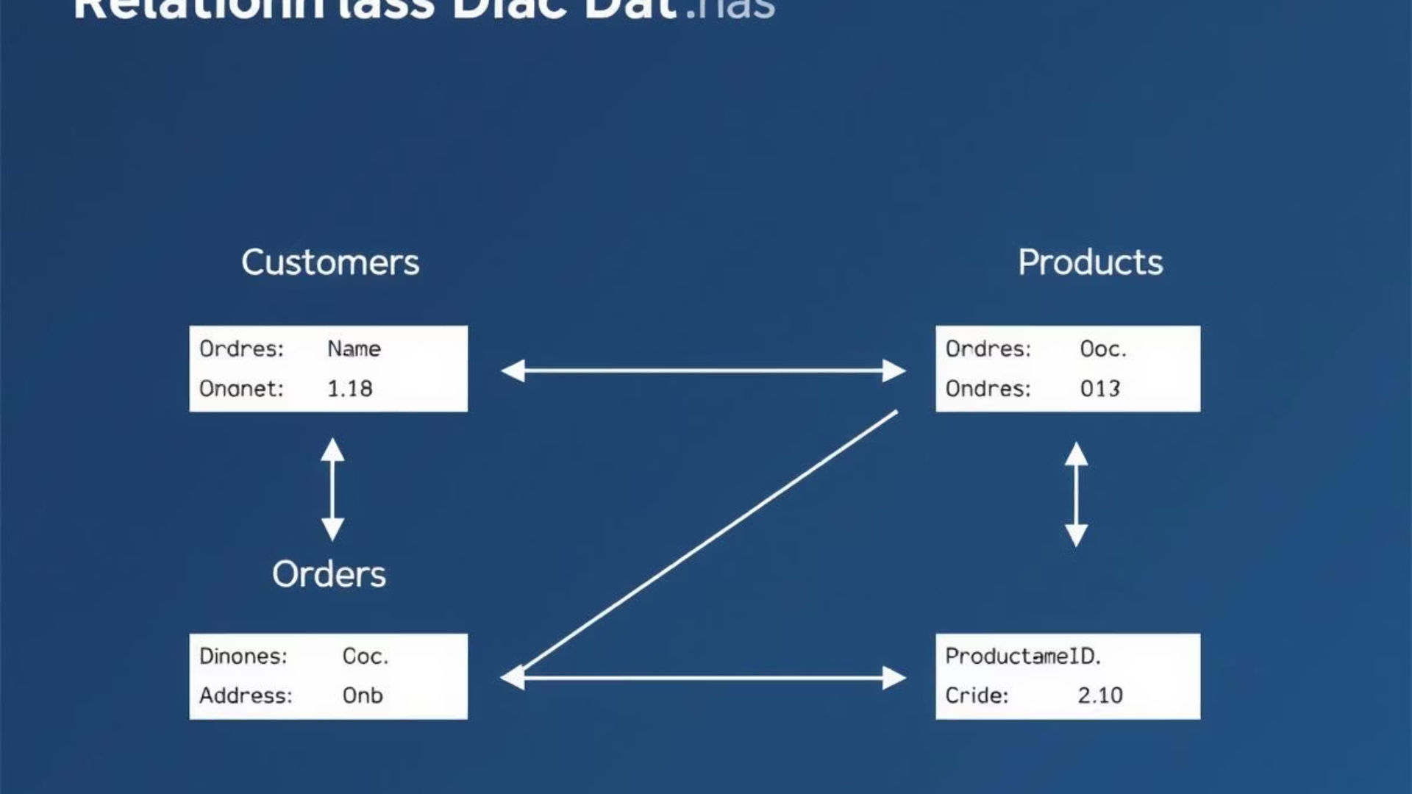
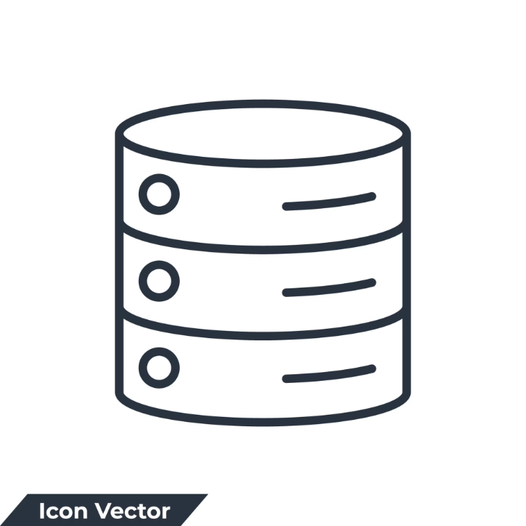
8.Database Design
Normalized structure for fast access
Tables: Users, Medicines, Inventory, Suppliers, Sales, etc.
Relationships handled using foreign keys
Notes:
10

Slide 11
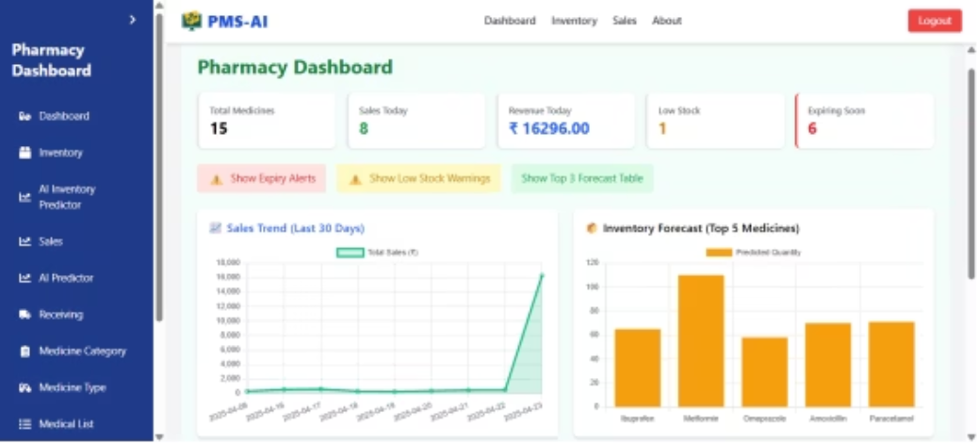
9.Results and Output
1.Dashboard
Displays key pharmacy metrics like sales trends, inventory status, and expiry alerts at a glance.
Interactive charts and animated cards make data easy to understand and act upon.
Real-time updates help pharmacists make faster, smarter decisions.
Notes:
11

Slide 12
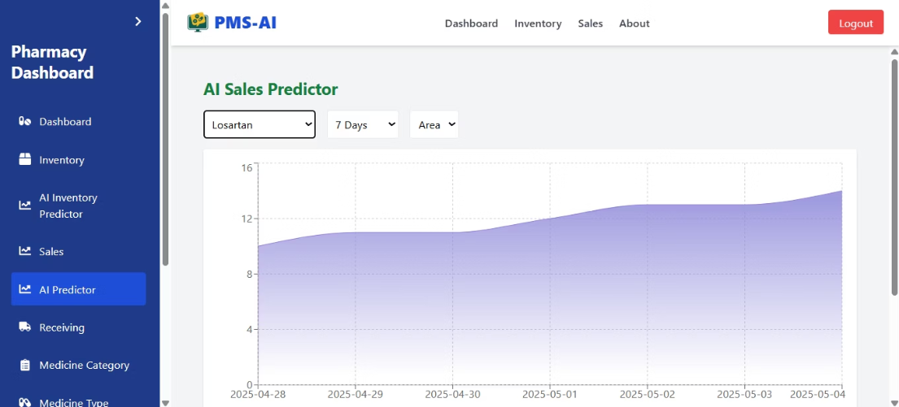
2.Sales Predictor
Predicts future sales based on past transaction data using machine learning (Linear Regression).
Forecasts quantity and revenue for 7 days, 1 month, 3 months, or 6 months intervals.
Helps optimize inventory by providing insights into upcoming demand patterns.
Notes:
12

Slide 13
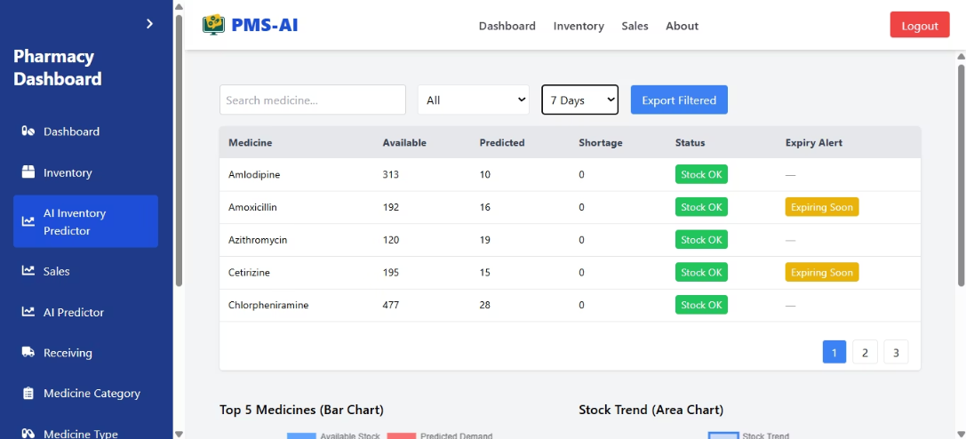
3.Inventory Predictor
Estimates future stock requirements using past sales and inventory trends.
Prevents stockouts and overstocking by forecasting medicine demand accurately.
Supports smarter purchasing decisions based on real-time data analysis.
Notes:
13

Slide 14
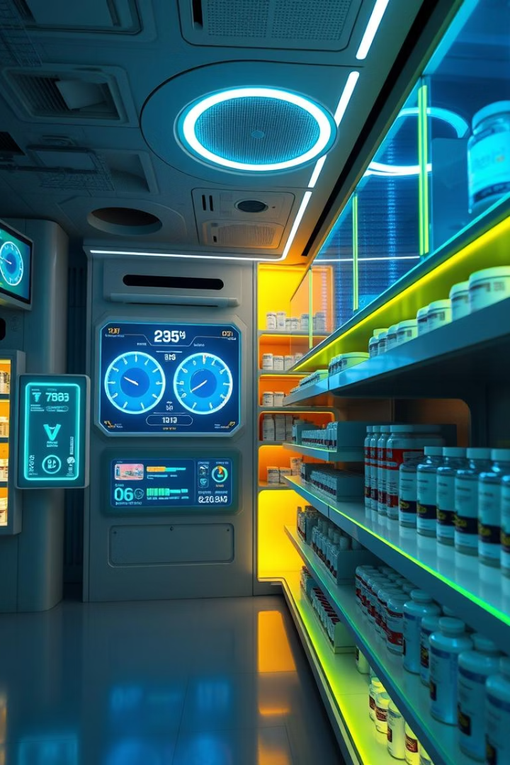

10 Conclusion
System meets pharmacy needs with smart features
AI model improves forecasting accuracy
Scalable, adaptable for clinics and large chains
Future scope: QR scanning, mobile app, multi-store support
Notes:
14

Slide 15

Q&A
We appreciate your time and interest. Please ask your questions.
Open Discussion
Feedback Welcome
Next Steps
Clarify any points or explore further details on the system.
Your insights help us improve and tailor the solution.
We look forward to collaborating and moving forward together.
Notes:
15

Slide 16

Thank You
Notes:
16

